Slide 1
Introducing Coordinate Systems and Map Projections

Slide 2
Introduction:
The unique characteristics of GIS as compared to other information systems is the spatial data.
These spatial data include coordinates that define location, shape, and extent of geographic objects.
The primary requirements of coordinate is to give a unique reference of location. However, the earth has an irregular shape. This also affects how we best map the surface of the Earth.

Slide 3
Reference surfaces
The physical surface of the earth contains variety of irregular landforms, such as plains, valley, water, mountains, and so on.
Due to these variations, there are two main reference surfaces used to approximate the shape of the Earth (or Earth figures).
They are the ellipsoid, and the Geoid.

Slide 4
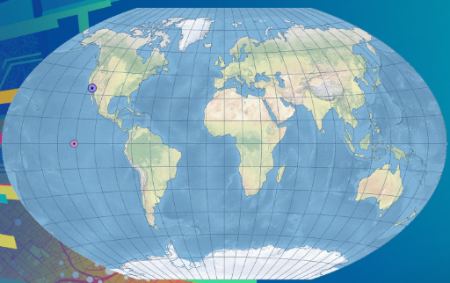
Where is my data?
Problem

Slide 5
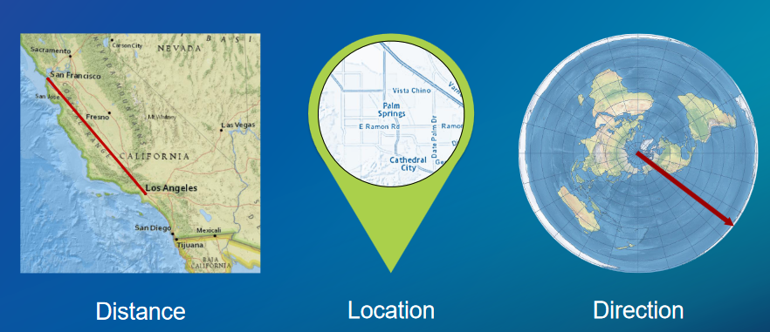
What does a coordinate system tell us?

Slide 6
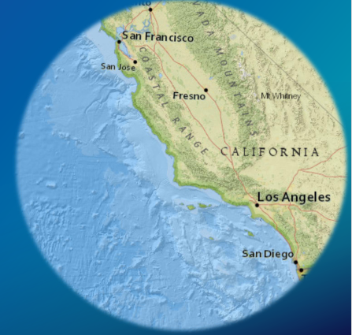
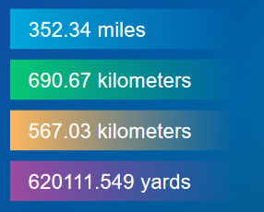
Distance
How far is it from San Francisco to Los Angeles?
It depends on the coordinate system.

Slide 7
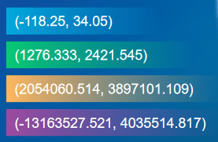
Location
What is the coordinate for
Los Angeles?
It depends on the coordinate system.

Slide 8
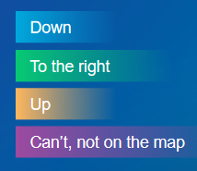
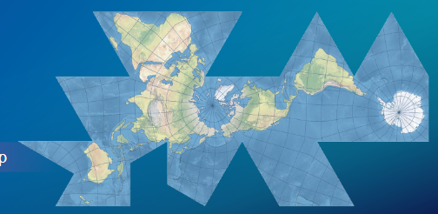
Direction
In which direction is the North Pole?
It depends on the coordinate system.

Slide 9
Understand Coordinate system
Terminology Used:
Coordinate system: A reference framework consisting of:
A set of points, lines and/or surfaces, and a set of rules,
Used to define the positions of points in a space,
In either two or three dimensions.

Slide 10
Understand Coordinate system
Coordinate systems measure positions on the ellipsoid in a two-dimensional (2D) or three-dimensional (3D) space.
They used to establish a common reference framework for display and analysis of spatial data.
There are two common types of coordinate systems: geographic (global) coordinate systems and projected (planar) coordinate systems.

Slide 11
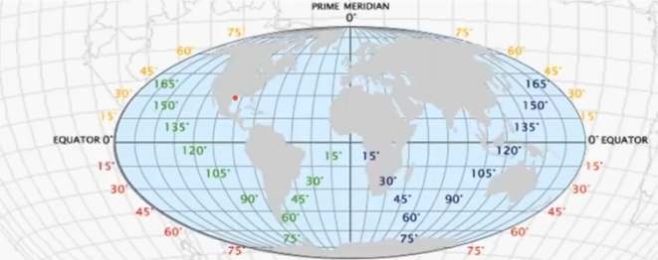
Geographic or global coordinate system (GCS):
Geographic Coordinate System: A reference system that uses:
Latitude (φ) and longitude (λ) to define the locations of points on the surface of a sphere or spheroid.
GCS defines locations on the earth using a 3D spherical surface.
A geographic coordinate system defination includes a datum, prime meridian and angular unit of measurement.

Slide 12

GCS values often recorded in degrees-minutes-seconds.
E.g. of latitude; or in decimal degrees;
e.g., longitude 80°E and latitude 55°N

Slide 13
Geocentric Coordinate System https://www.youtube.com/watch?v=ciztYK7n8o0
The formulae involved in computations based on ellipsoidal coordinates are complex, and entirely inappropriate when considering observations made to or from satellites.
Another method of defining a 3D position on the surface of the Earth is geocentric coordinates of (X, Y, Z);
Also known as a 3D Cartesian coordinate system.
The system has its origin at the mass-center of the Earth, where the three axes are mutually orthogonal.
The X- and Y-axes in the plane of the equator, while the Z-axis coincides with the Earth's axis of rotation.

Slide 14
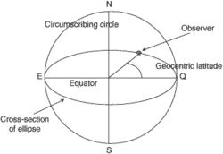
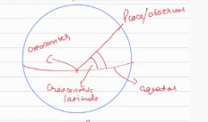
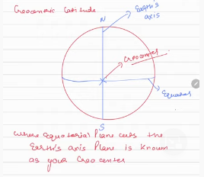
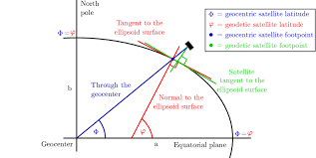
Diagram illustration

Slide 15
A Projected coordinate System
Projections are a mathematical transformation that take spherical coordinates (latitude and longitude) and transform them to an XY (planar) coordinate system.
This enables you to create a map that accurately shows distances, areas, or directions.
With this information, you can accurately work with the data to calculate areas and distances and measure directions.
As implemented in Geographic Information Systems, projections are transformations from spherical coordinates to XY coordinates systems and transformations from one XY coordinate system to another.

Slide 16
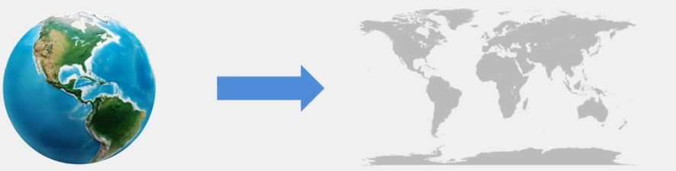
Why projections?
Map projections: potray the surface of the earth or portion of the earth (3D) on a flat peace of paper or on screen (2D).

Slide 17
Projected or planar coordinate systems
A projected coordinate system - A reference system used to:
Locate x, y and z positions of point, line and area features in two dimensions.
Map projections transform coordinate locations of latitude (φ) and longitude (λ) of into (grid) Cartesian (x, y) coordinate locations.
Unlike GCS, a projected coordinate system has the advantage that lengths, angles, and areas are constant across the two dimensions.

Slide 18
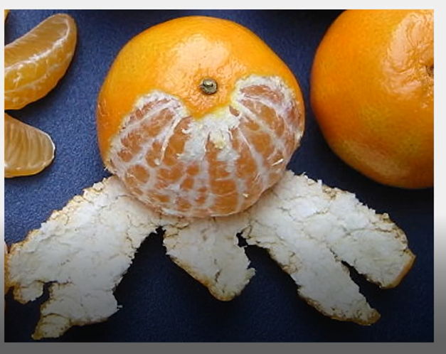
Problem associated with map projection:
The transformation from the earth’s surface to a flat surface involves distortion and NO map projection is perfect.
Properties of geographic objects that are distorted are:
Area
Scale
Shape
Direction

Slide 19
Projection components:
Projection type (name)
Projection units (x and y)
Datum
Spheroid (related to datum)
Zone (if state plane or UTM projection)

Slide 20
Types of projection
There is no universal criterion to classify projections types.
However, map projections described in terms of their developable surfaces (cylindrical, conical or azimuthal).
In terms of their distortion properties (equal-area, equidistant, and conformal);
And in terms of their orientation of projection plane relative to the globe, called aspects (normal, transverse and oblique)

Slide 21
Types of projection based on their distortion properties
Common distortion properties of the projected map are equal-area, equidistant, and conformal.
They are described according to what is not distorted in area, shape, direction, angle, distance (bearing), and, scale.

Slide 22
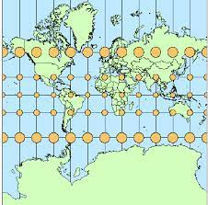
Conformal (Orthomorphic) projections
Conformal projections preserve local shape by maintaining the same scale in any direction for any map location, but distort area (i.e. some places look bigger than their actual area).
A good example of conformal projection are:
Mercator - rhumb lines are represented by straight segments
Stereographic - shape of circles is conserved
Roussilhe
Lambert conformal conic
Quincuncial

Slide 23
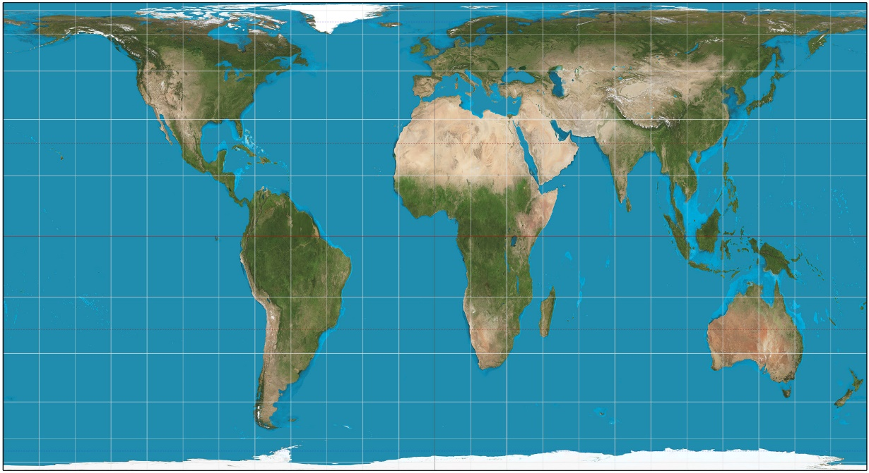
Equal-area Projection
Accurately represent the size of landmasses and oceans, but distort shape, scale, and/or angle.
These projections preserve area.
Examples of Equal-area projection are
Gall orthographic (also known as Gall-Peters, or Peters, projection)
Albers conic
Lambert azimuthal equal-area
Mollweide
Hammer
Briesemeiste

Slide 24
Equidistant
These preserve distance from some standard point or line:
Examples of equidistant projection are:
Plate carrée - north-south scale is constant
Equirectangular - equal distance between all latitudes and longitudes.
Azimuthal equidistant - radial scale with respect to the central point is constant
Equidistant conic

Slide 25
THANKS

